Slide 1
San Jose vs New York

Slide 2
A Hypothetical Scenario by Anish S

Slide 3
Premise
Given one would want to begin a startup around recyclable single-use tableware, where would be the best location? Between the tech-based, ‘Silicon Valley’ area San Jose, or the most populated US city, New York City? And within the cities, which area?

Slide 4
Process
Acquire data
Analyze data
Display results

Slide 5
Acquire Data
The data was acquired through python, using the geopy library as well as using the Foursquare API to identify the venues in San Jose and New York.

Slide 6
Analyze Data
The data was mapped, and after the venues in both cities were identified, they were clustered into three clusters per each city, and then the biggest cluster was identified as the biggest group of customers, and of which the center would be the best location for the startup.

Slide 7
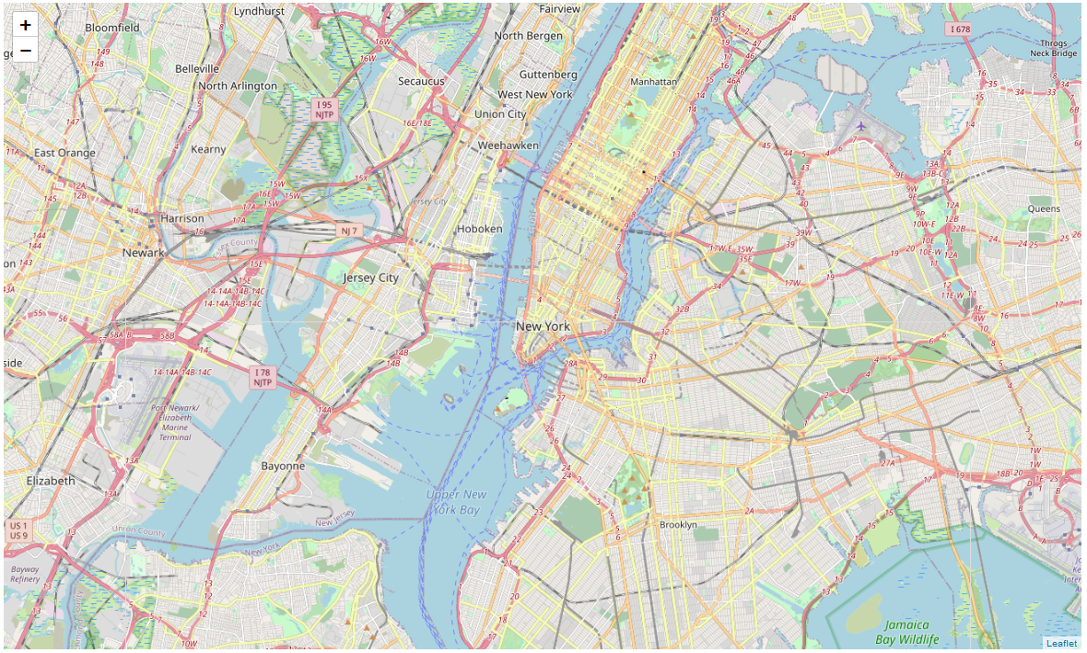
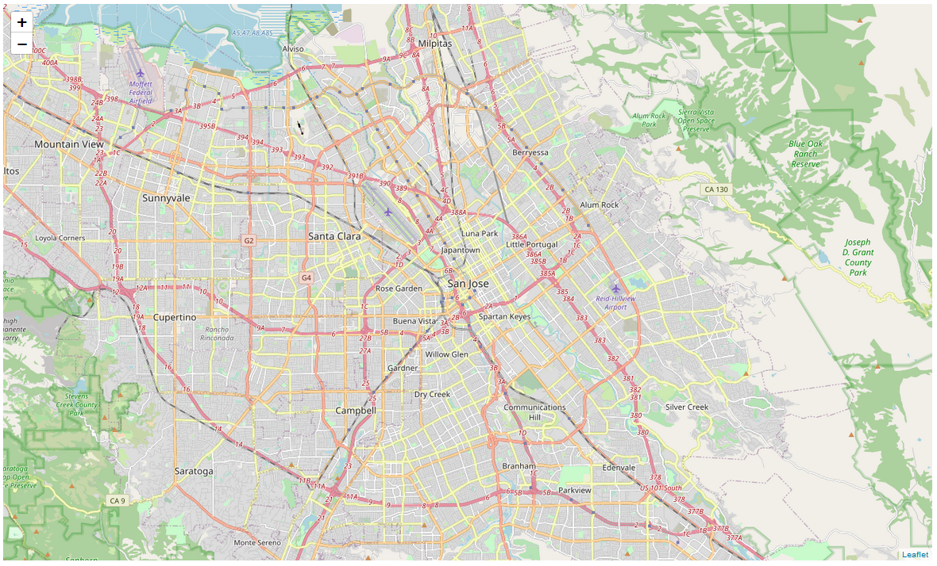
Visuals: San Jose and New York
New York (left) and San Jose (right)

Slide 8
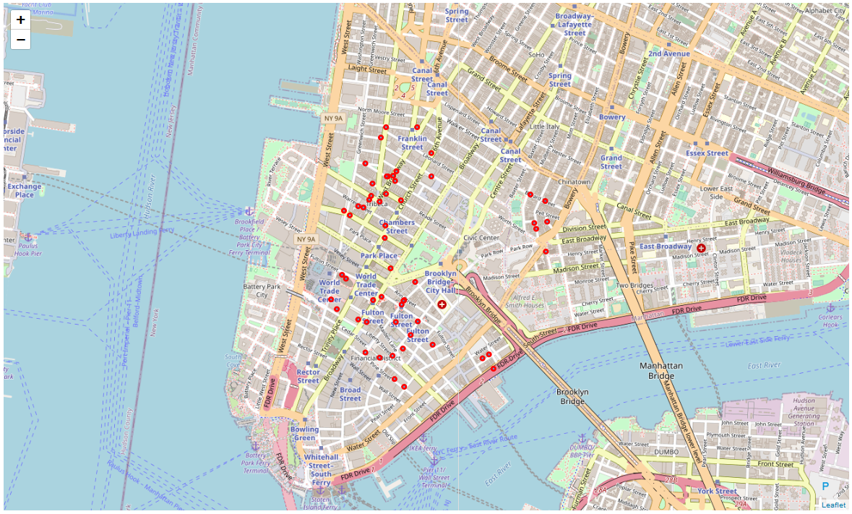
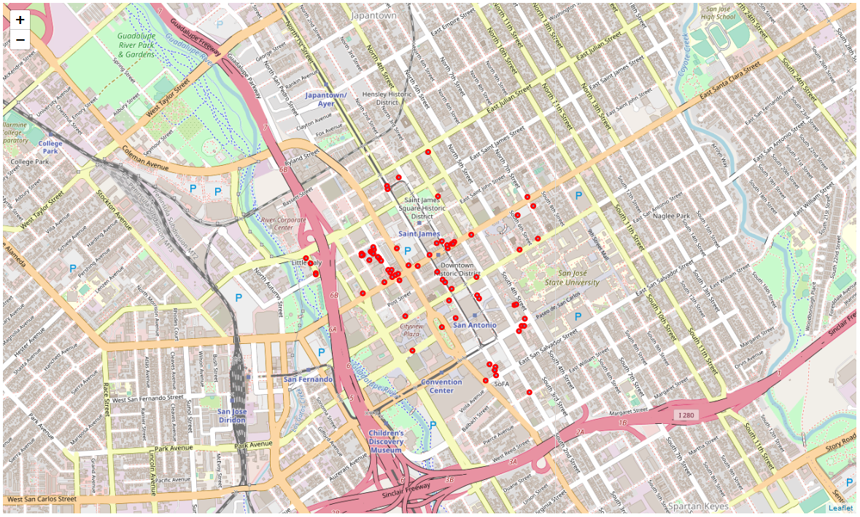
Visuals: Venues in Both Cities
Food Venues of New York (left) and San Jose (right) in Red

Slide 9
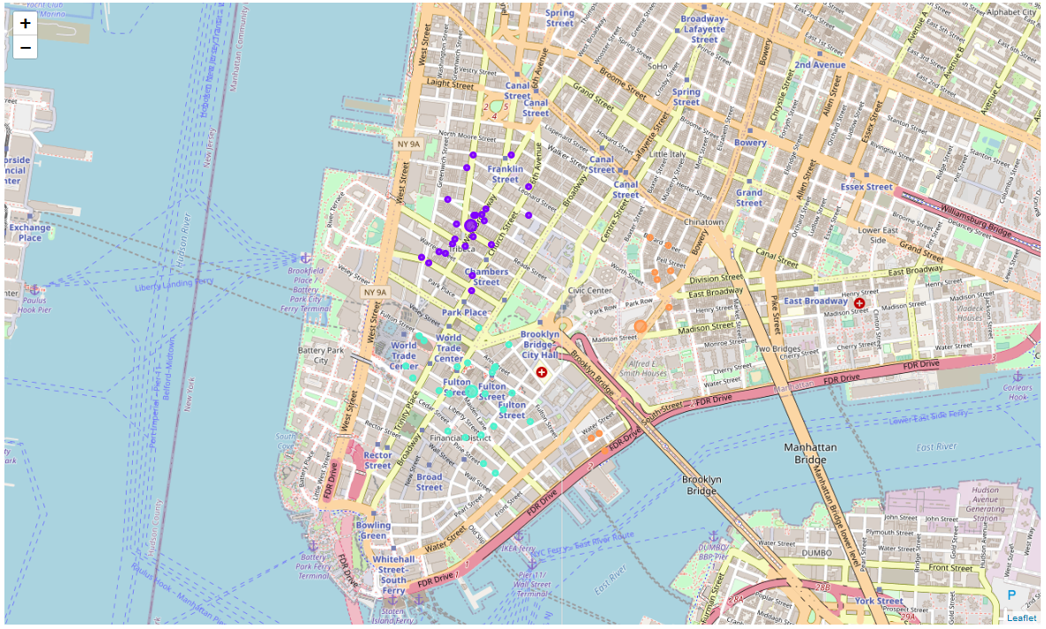
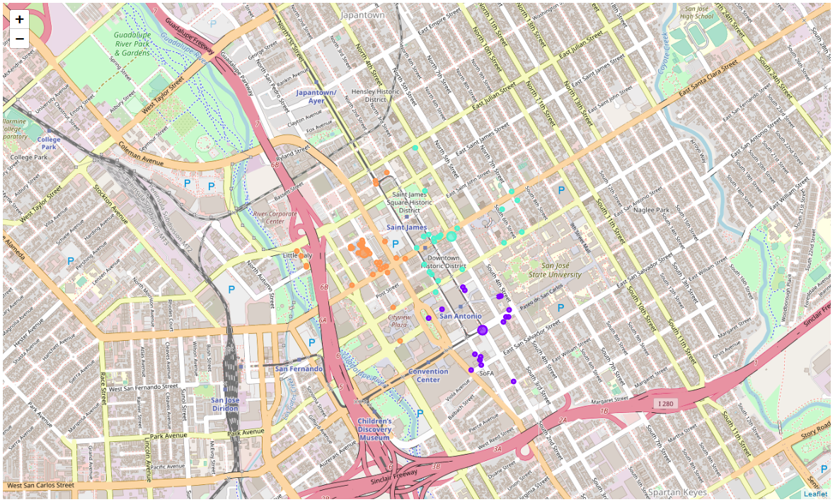
Visuals: Clusters of Venues
Clustered Food Venues of New York (left) and San Jose (right)

Slide 10
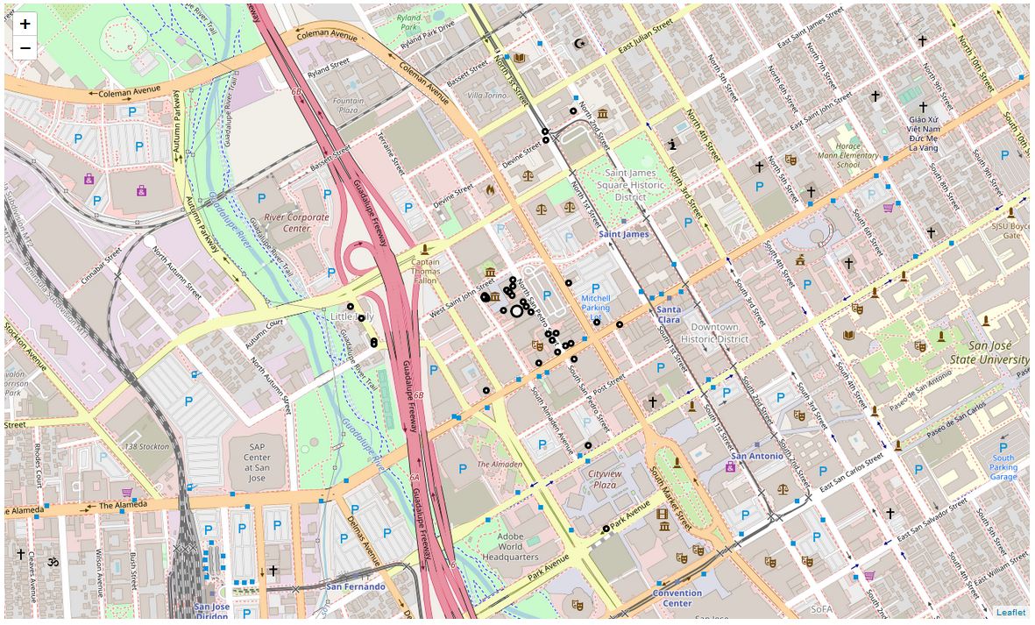
Visuals: Final Cluster in San Jose
Cluster in San Jose with the Most Food Venues (Center: The Old Spaghetti Factory)

Slide 11
Results
The best location for the startup is The Old Spaghetti Factory, San Jose, CA. This is the center of the largest cluster (37 venues) and would maximize benefits.

Slide 12
Conclusion
Given such a hypothetical scenario, the best location for the startup would be the Old Spaghetti Factory in San Jose. While there are future improvements that are possible, those are for a later date. Based on all this, the location is given: the only requirement is someone willing to start the project up.

